Slide 1
Your Python Environment
ASRI DART Summer Workshop
Stephen R. Addison
University of Central Arkansas
June 06, 2023

Slide 2
Setting up your environment
For the beginner python track, there is nothing to download, and nothing to install. I will be showing you how to use an online virtual environment that enables you to write code in a Jupyter Notebook. This is the Google Colaboratory.
You could install Python and all the needed packages on most of your computers, but there are frequently difficulties, and we want to get you to a point where you have a workable tool, and we don’t want you to have to spend lots of time configuring your environment.
So we’ll be using the Google Colaboratory, or Colab for short.

Slide 3
What if you want to set up your own environment?
If you want to install a local distribution, you could install the Anaconda distribution. You can find it here: https://www.anaconda.com/
This can install everything including both R and Python and all the things that go with it.
If you want to use python.org and install the IDE of your choice, I provide some advice in the following: http://uca.edu/go/844534
This is an article that I wrote for medium about an interactive version of the course that I have been developing.

Slide 4
Programming
Learning to program changes the way you think about the world - all sorts of problems become tractable.
At first it will seem like you are just learning a series of tricks, and you may struggle but soon, you will realize that if you can program it can help you to think and reason about the world.
Python is a great language to start with. While it is an object oriented language we will mostly be using it to do procedural programming.

Slide 5
So, where do you download it ?
I reiterate, I’m going to use Google Colab which doesn’t require a download.
Here is a link to Google Colab:
https://colab.research.google.com/
I’m going to want you to go there in a few minutes, but I do want to show you what to expect when you get there, but first let’s talk about what it is.

Slide 6
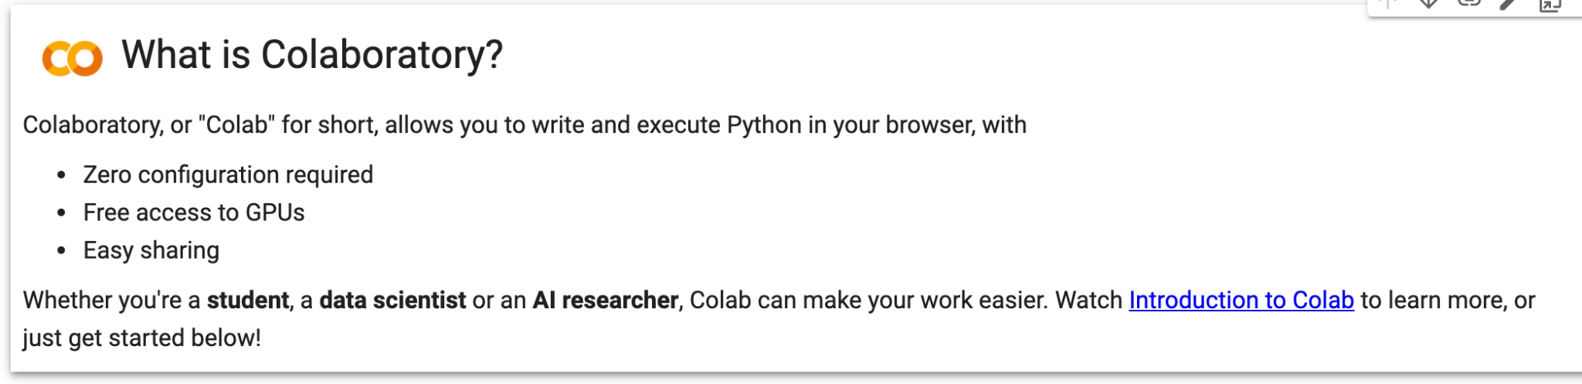
Google Colab

Slide 7
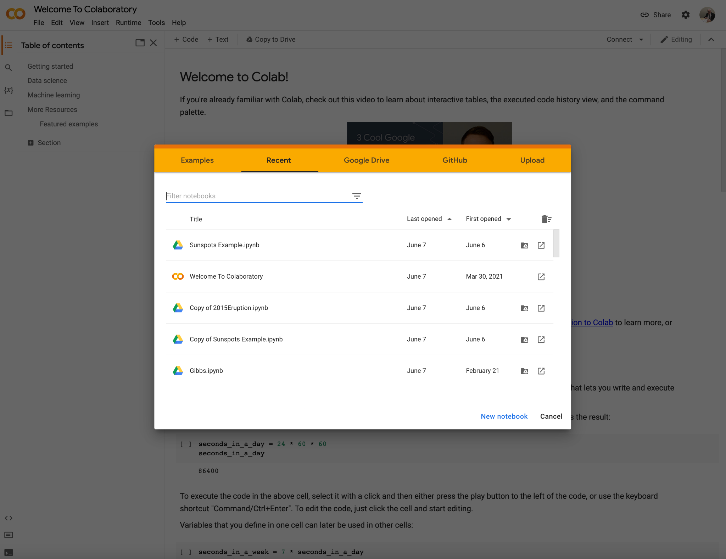
Now click on
New Notebook

Slide 8
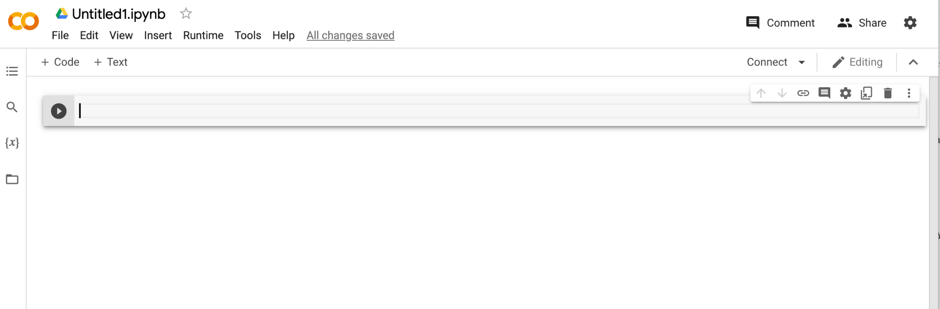
This should create your first Jupyter Notebook. It will save automatically on your Google Drive.
The first thing you should do is to rename it. You can either click on Untitled and change it to something else. Or you can click on File, followed by selecting “rename” this just takes you to the same place. So type something in. Don’t delete or change the file extension!

Slide 9
Now let’s do something -select “text”
We’ll go to the program and insert some text and then we’ll execute some code blocks.

Slide 10
Now let’s insert some code
Just click on code if you want to run some code or just use Colab as a calculator.

Slide 11
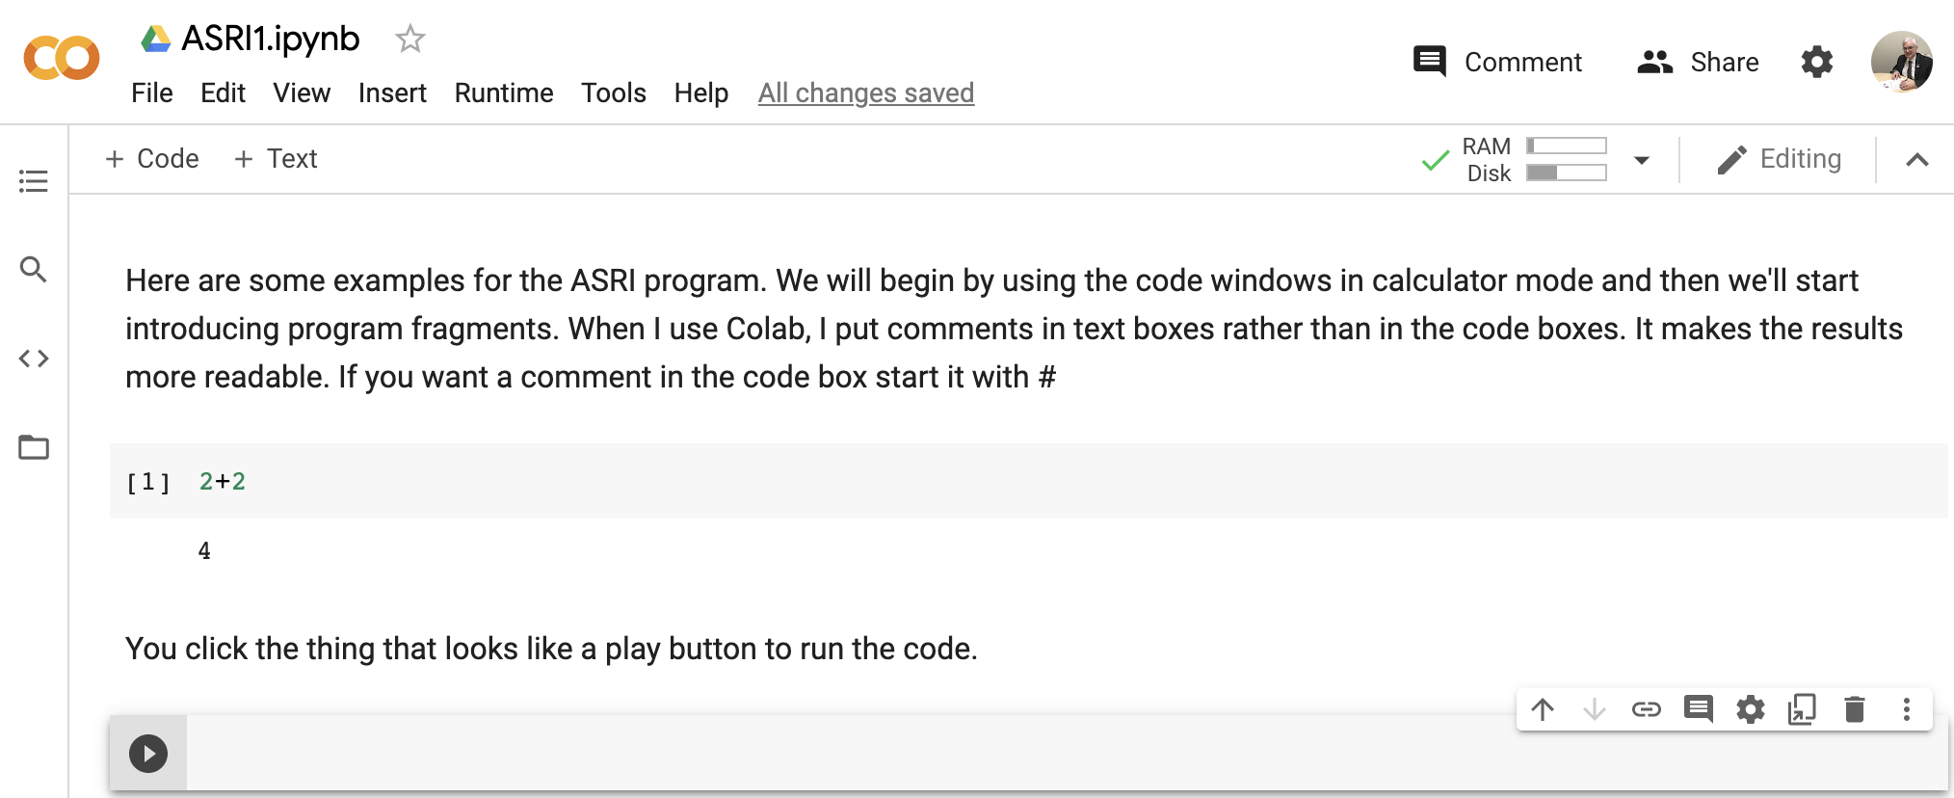
Let’s start with the some text, and a calculator problem

Slide 12
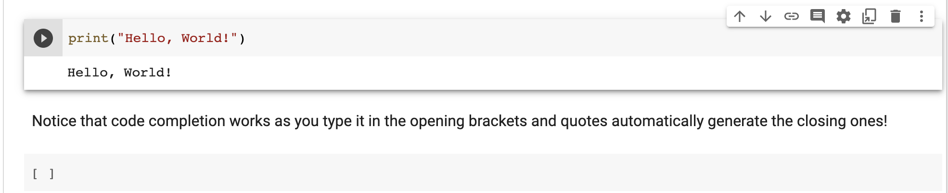
The window does code completion - be careful with this!

Slide 13
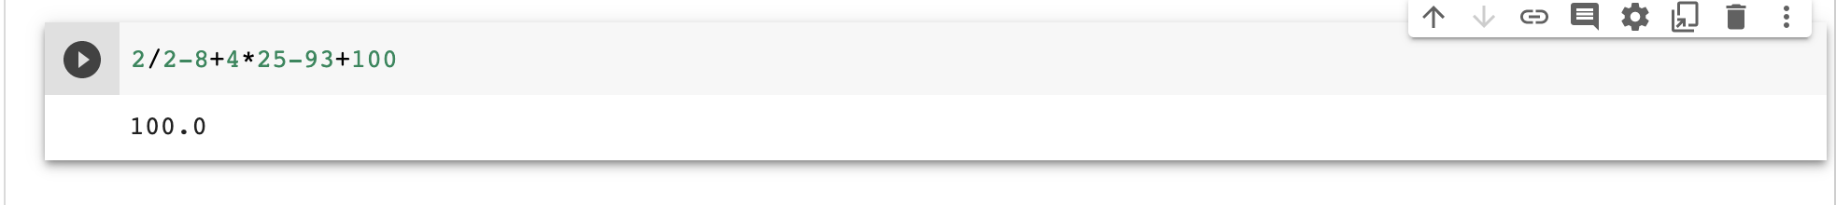
Python uses standard order of operations (PEMDAS). But look up operator precedence when you evaluate functions. Caution, it’s not the same as in C and C++

Slide 14
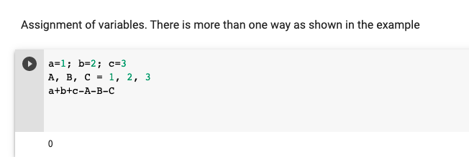
Two ways to assign variables

Slide 15
Python Modules
Python doesn’t have many built in functions. In order to access functions, we import modules either in whole or in part. It is often best just to import the functions you need as the same function names might be used in different modules and you want to be sure that you are using the function that you think you are using. You don’t want your functions to be black boxes, you would like to know what they are doing and what their limitations are.

Slide 16
Python Modules
Examples include
math
numpy
Scipy
matplotlib

Slide 17
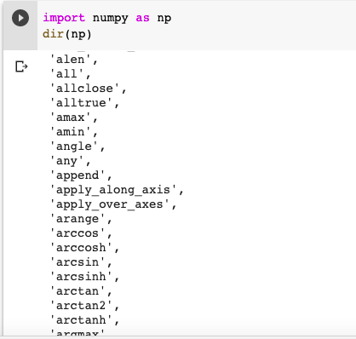
I could have just used import numpy, dir(np) lists 600+ additional functions

Slide 18
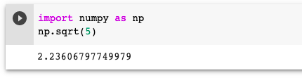
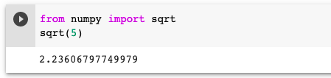
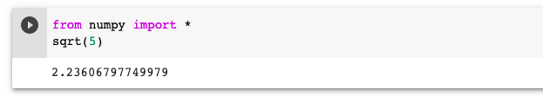
Three ways, in order of my decreasing preference

Slide 19
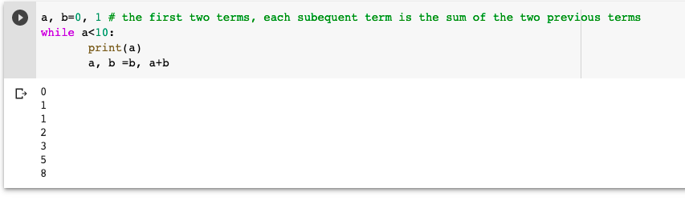
This is the Fibonacci sequence with each term the sum of the two that went before. In this example, I’ve introduced a while loop. You can keep executing while a condition is true, this is very useful if you don’t know how many loops it will take!
Note that the loop code is indented. Blocks of code are identified only by indentation.
Q: How would I need to change the condition to print 1 more term? (Code from the official Python Tutorial)

Slide 20
Logical flow of the code
Let’s see what the while loop does, we start from a=0, b=1 and print a
a=0, b=1, print 0
a=1, b=1, print 1
a=1, b=2, print 1
a=2, b=3, print 2
a=3, b=5, print 3
a=5, b=8, print 5
a=8, b=13, print 8
a=13, b=21, print nothing

Slide 21
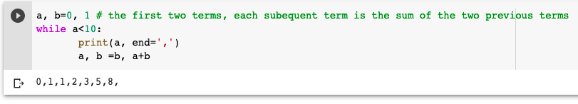
The keyword argument end can be used to avoid the newline after the output, I used it to replace the newline with a , in the above example.

Slide 22
Basic operations
addition
subtraction
* multiplication
/ division
** exponentiation
// floor division (yield integer part only in division)
% modulo (yields remainder in division)

Slide 23
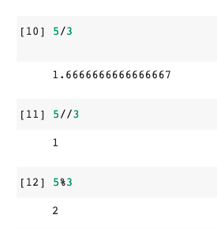

Slide 24
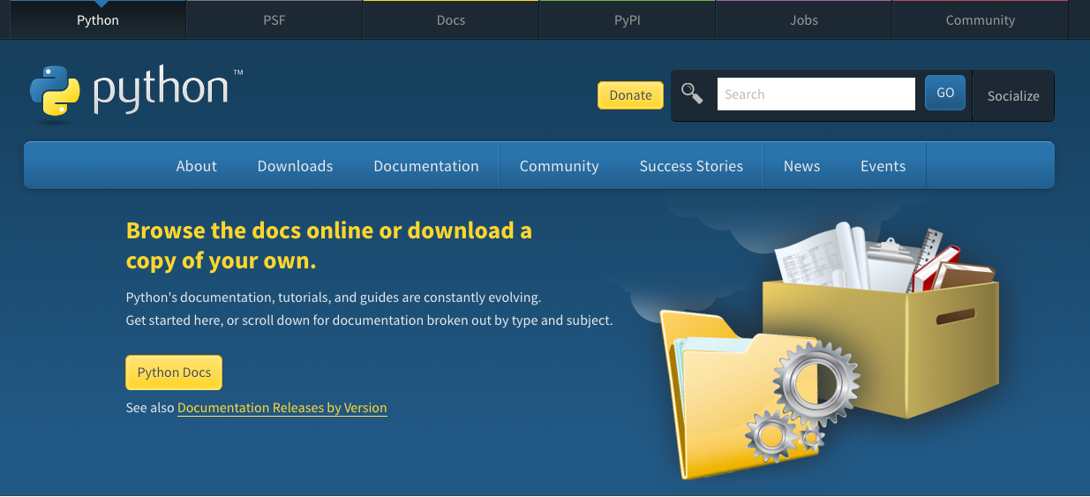
Resources
Where can I find free resources to help me learn Python programming
python.org

Slide 25
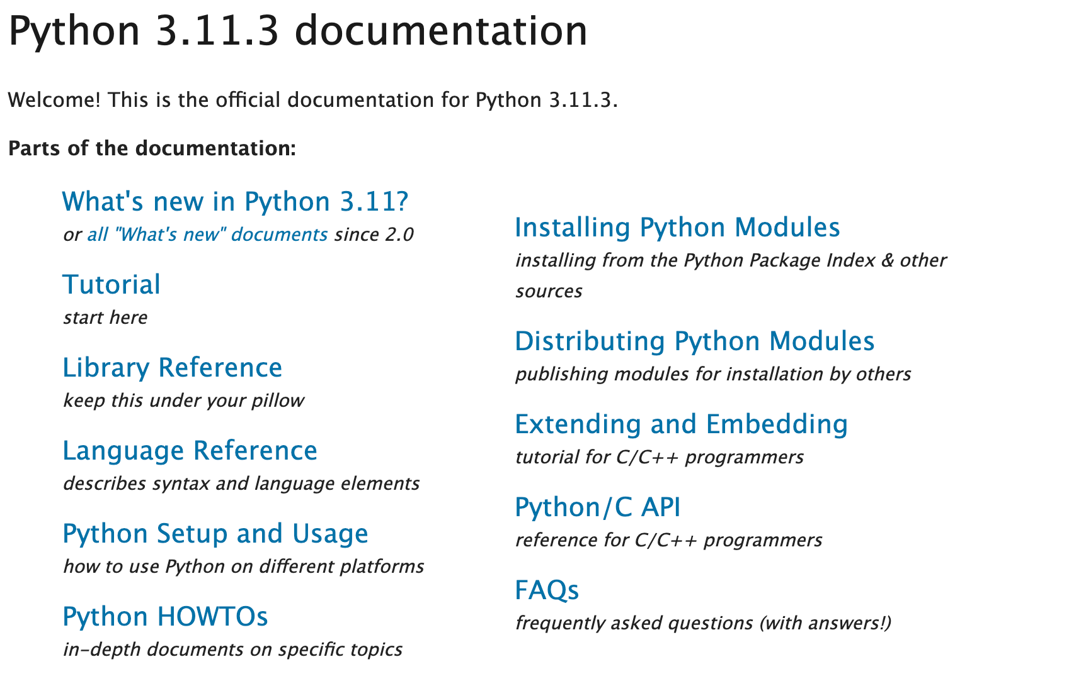
Most of What you need to know is here, start with the tutorial

Slide 26
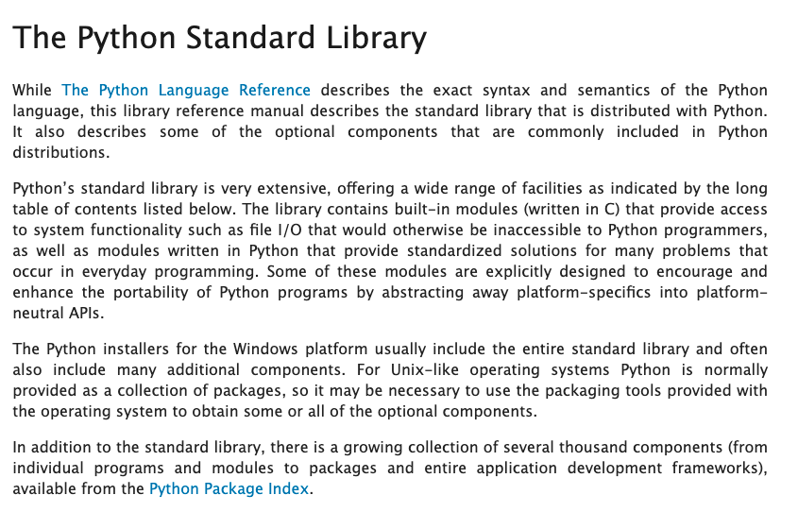
The Python standard library is a very useful tool.

Slide 27
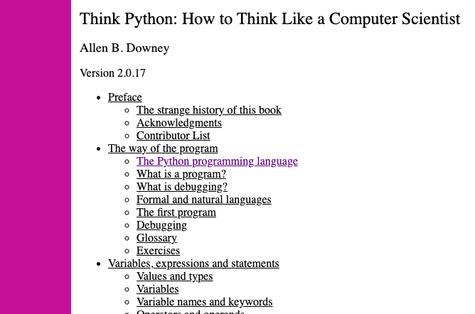
https://greenteapress.com/thinkpython/html/index.html

Slide 28
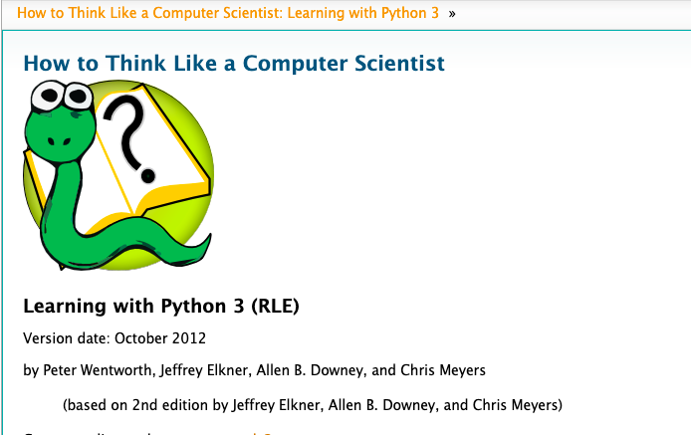
http://openbookproject.net/thinkcs/python/english3e/

Slide 29
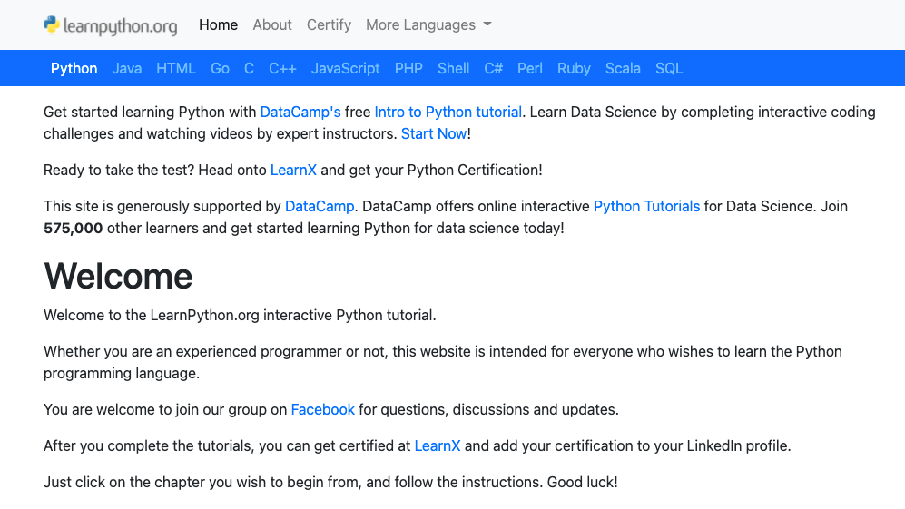
https://www.learnpython.org/

Slide 30
Here are some Python distributions

Slide 31
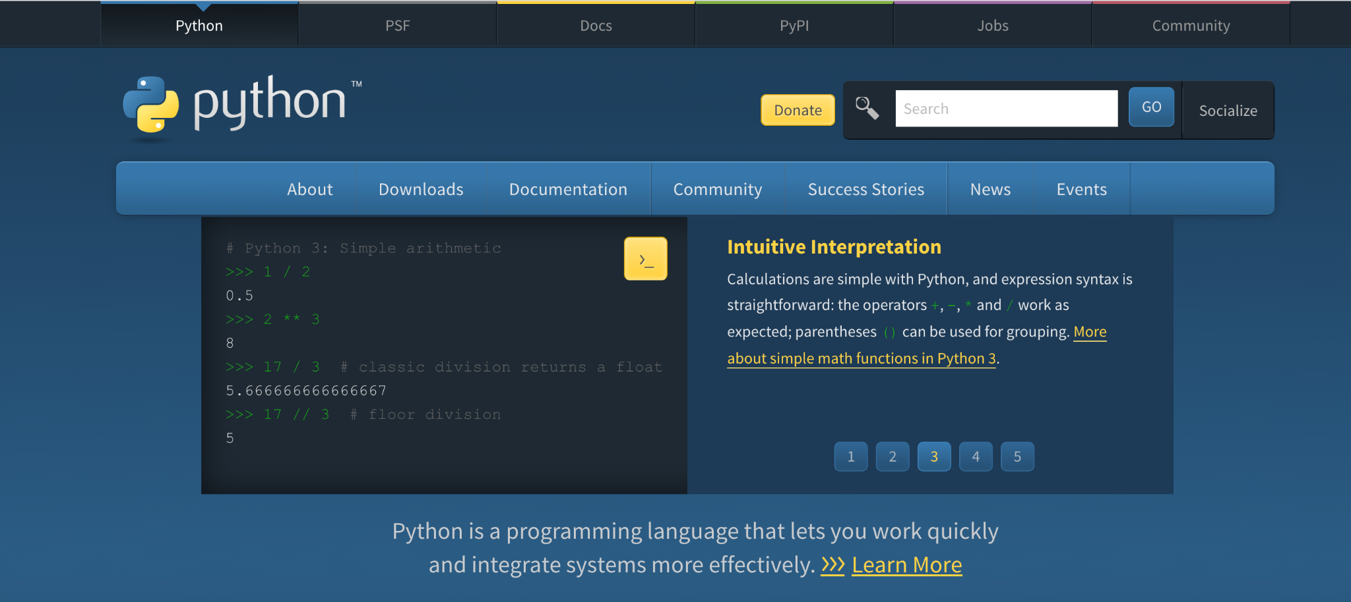
Python.org https://www.python.org/

Slide 32
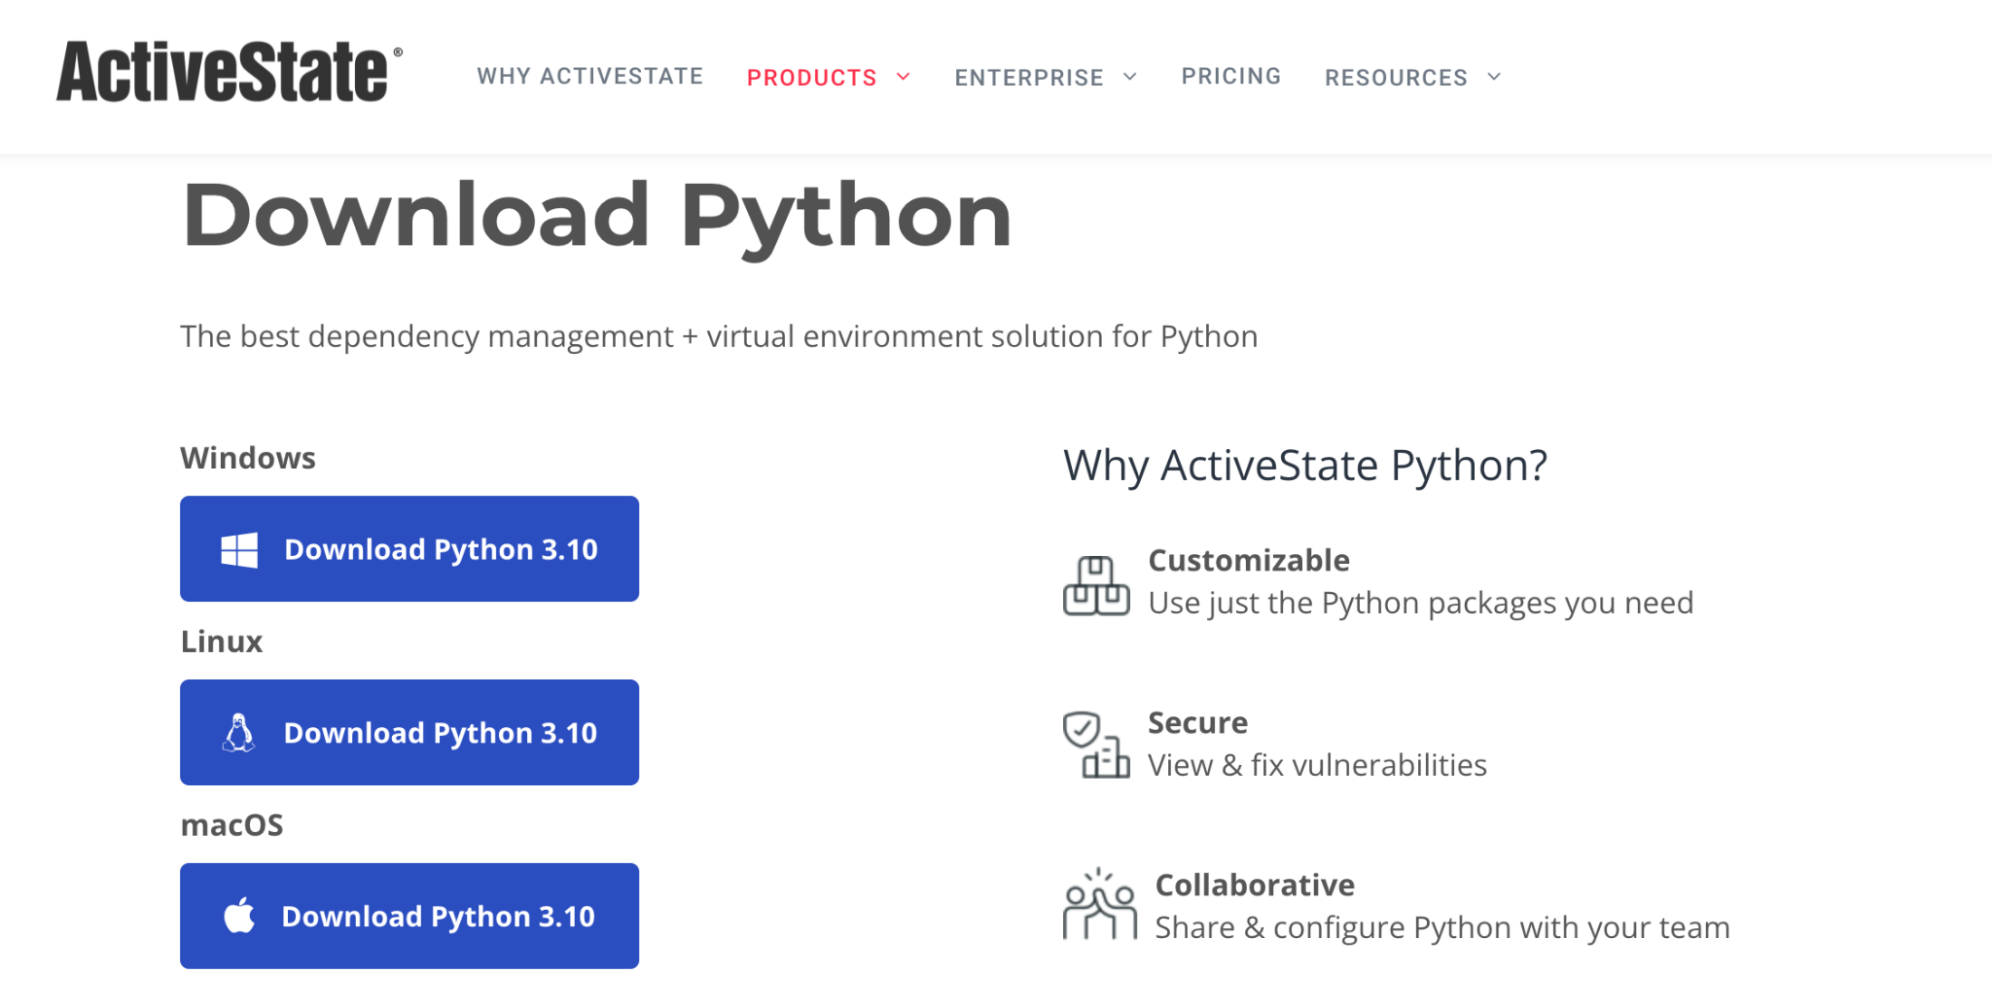
ActiveState Python

Slide 33

Anaconda Python: https://www.anaconda.com/

Slide 34
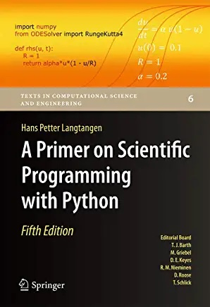
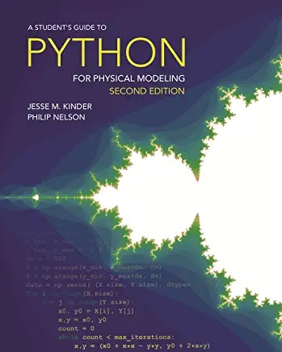
Reference Material

